Slide 1

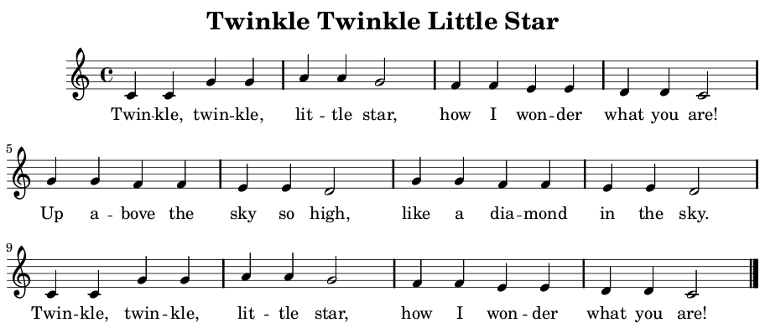

APPLIED PHYSICS 186
DR. MARICOR SORIANO
Activity 9
Interpreting a
MUSICAL SCORE
https://upload.wikimedia.org/wikipedia/commons/9/90/Twinkle_Twinkle_Sheet_Music.png
RENE L. PRINCIPE JR
2015-04622

Slide 2
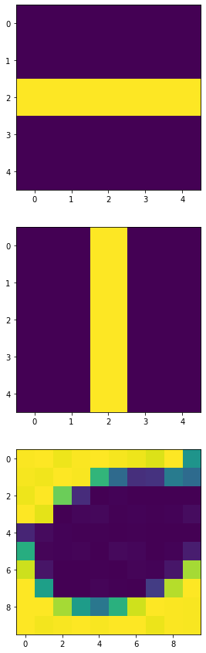
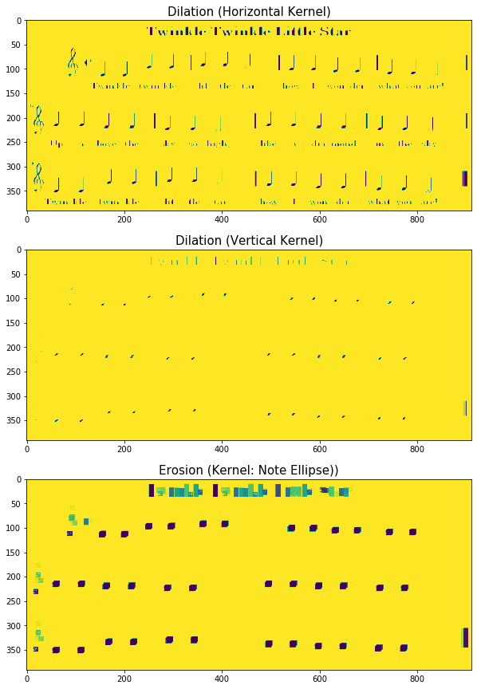
In this report, the quarter notes and half notes of the “Twinkle Twinkle Little Star” musical score sheet in Figure 1 shall be extracted. The first challenge was trying to remove everything else (staff lines, G-clefs, letterings, etc. I tried applying the skills I acquired previously in the Morphological Operations activity, where a horizontal dilation kernel shall remove the vertical lines while a vertical dilation kernel shall remove the horizontal lines on the sheet. After applying numerous dilation and erosion operations, my results as shown in Fig. 2 were able to locate the quarter notes however, a lot of artifacts are still present on the final results. I removed these artifacts by further applying Open CV’s GuassianBlur and thresholding. After this pre-processing stage, what’s left are irregular contours of the quarter notes. There’s no need to worry because what we’re after is the pixel location of these contours. For this, I used OpenCV’s findContours package. The problem with this package is that it automatically sorts the coordinates list.
Figure 2. Manually applying morphological operations to the musical sheet using the kernel at the left sides. The resulting image is shown on the right side and after the final operation, the location of the quarter notes were the only ones obviously detected, however, a lot of unwanted artifacts are still visible.

Slide 3
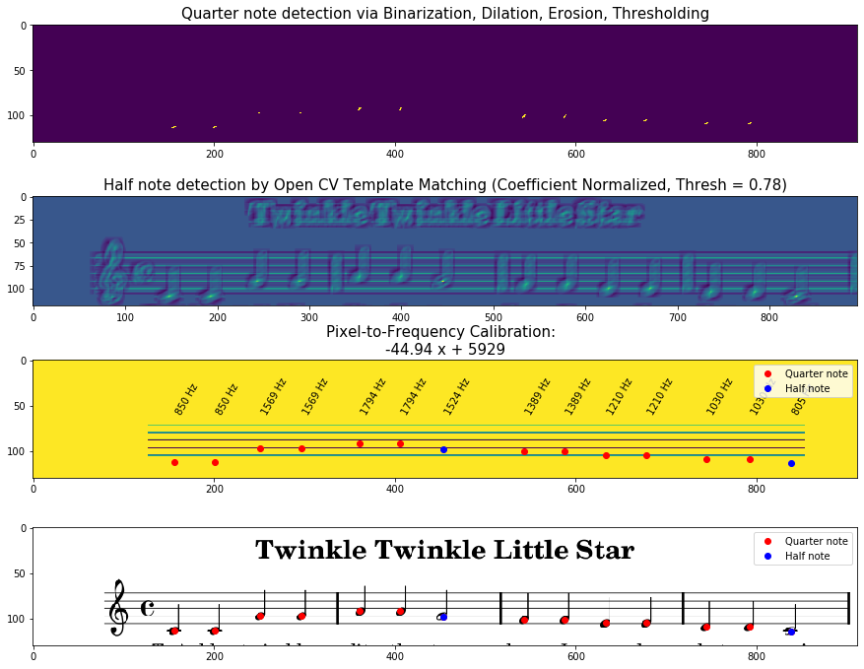
To facilitate the upcoming problems, I opted to do the command sequence on a Section of Interest (SOI) in the musical sheet. Each SOI shall contain one staff only, and so, I have now three sections. For each section, The quarter note coordinate was extracted using the method earlier. Meanwhile, a template matching package in OpenCV was used to detect the location of the half note using a half note template. All of these coordinate pairs were stored on a list. Now, each line on the staff has a known frequency. From the five lines, a linear regression was carried out to determine the calibration curve. This calibration curve shall return a frequency value given the pixel’s y-coordinate. A list of frequency values can then be obtained to match with the list of ordered pairs. The lists were all sorted to match an increasing x-coordinate value to follow the convention of left-to-right note reading. For the duration, a separate list was created such that each detected quarter note will append a value of 500 ms, while half notes appends 1000 ms. Visualization of the steps implemented in each sections are shown in Fig.s 3,4,5.
Figure 3. After applying various operations on the Section of Interest, the pixel coordinates of the notes are now known, as shown in the first two images. Extraction of staff coordinates was used to come up with a calibration equation which relates pixel location to frequency exclusive for the Section of Interest only. Using this, the frequency of the notes were determined. It is safe to say that the coordinate extraction was successful as shown by the last image, where the plotted coordinates superimposed on the sheet coincide with the notes.

Slide 4
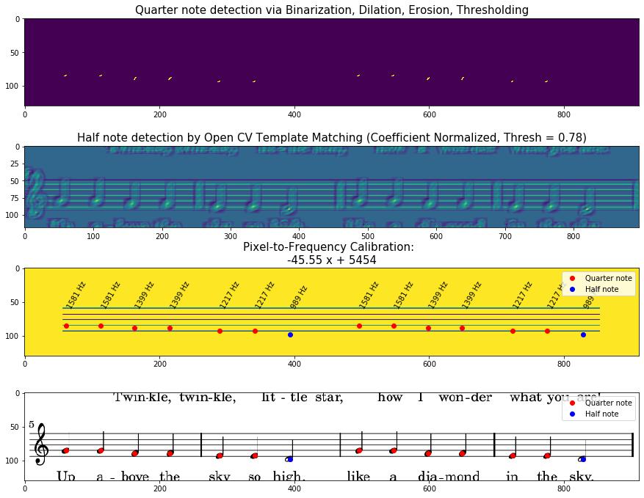
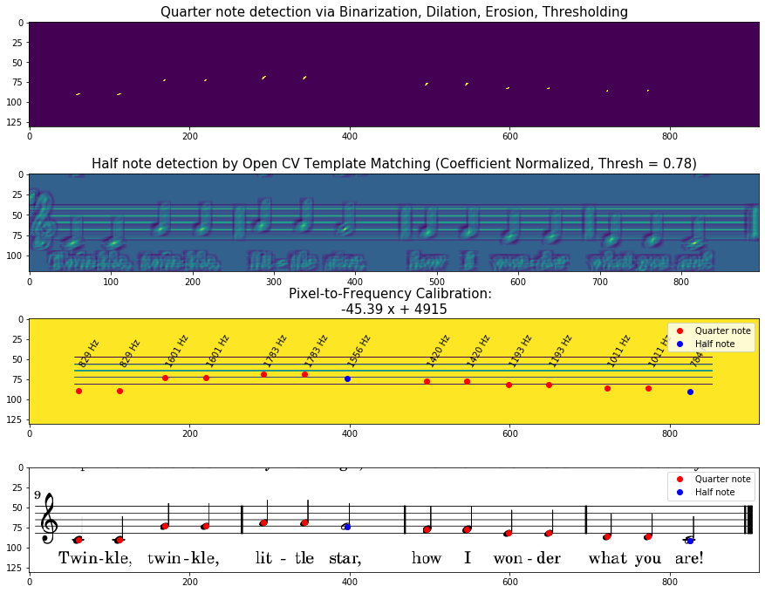
Figure 4. Coordinate and frequency extraction on musical notes in Section 2
Figure 5. Coordinate and frequency extraction on musical notes in Section 3

Slide 5
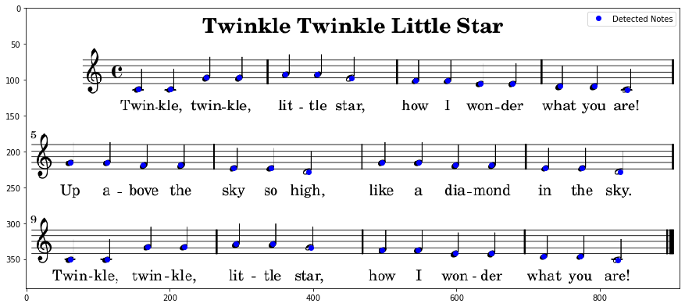
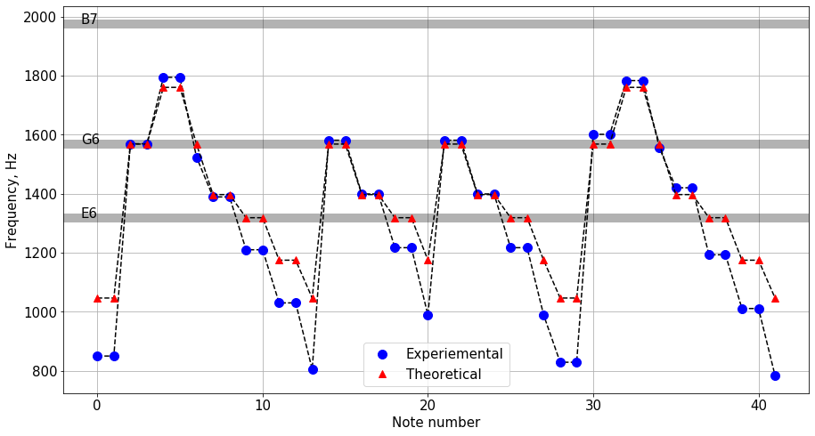
Figure 6. Overall coordinate extraction and frequency determination results. The plot shows how my experimental frequency deviates from the actual frequency.
Overall, I successfully extracted the coordinates of quarter notes and half notes as shown in the top image in Fig 6. Upon playing the audio in WinSound, the deviations of my calculated frequencies manifests as sharp/flat notes. This is because the calculation of frequency is based on the equation of the line of the calibration, instead of the actual discretized one. Results could also further be improved by implementing more appropriate thresholding and morphological operations.
I want to thank my classmates (Joanne, Kenneth, Rhei, CriCri, etc.) for attending to my questions indefinitely. In this activity, I’d give myself a score of 9 ..
References:
M. Soriano, “Playing notes by image processing,” 2019.
theoretical frequencies: https://pages.mtu.edu/~suits/notefreqs.html

